Slide 1
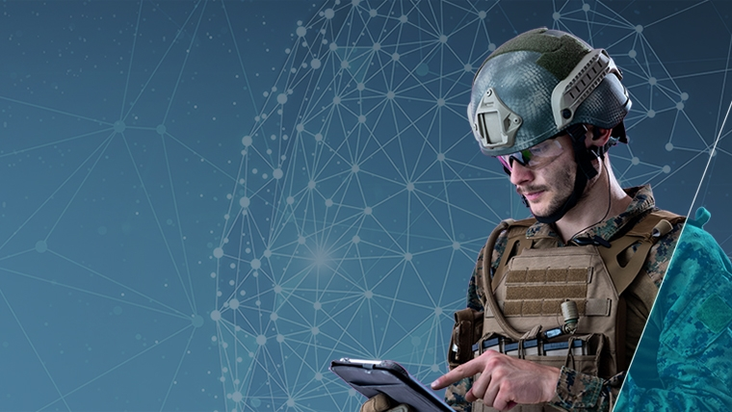
ADVANCED MILITARY GRADE SUIT

Slide 2
INTRODUCTION
Smart Armored Nexus Integration (SANI) project is an advanced suit, which can take information from areas without putting a soldier in danger.
It can also create virtual environment / augmented reality which can be crucial for information gathering.
It mainly has three parts namely- Raspberry PI, Power Source, Screen with a GUI.

Slide 3
OBJECTIVE
The main objective of this project to create an advanced suit for military and/or disaster relief to help collect information without putting resource into danger.
It is to be made such that the local inferences doesn’t affect the functioning of the suit. It is equipped with functionalities like conversational AI (SANI), Object Detection, Remote access and Hands-free operations.

Slide 4
The Advanced Military Grade Suit contains :
An Arc Reactor
A Graphic User Interface for AI
A Screen

Slide 5
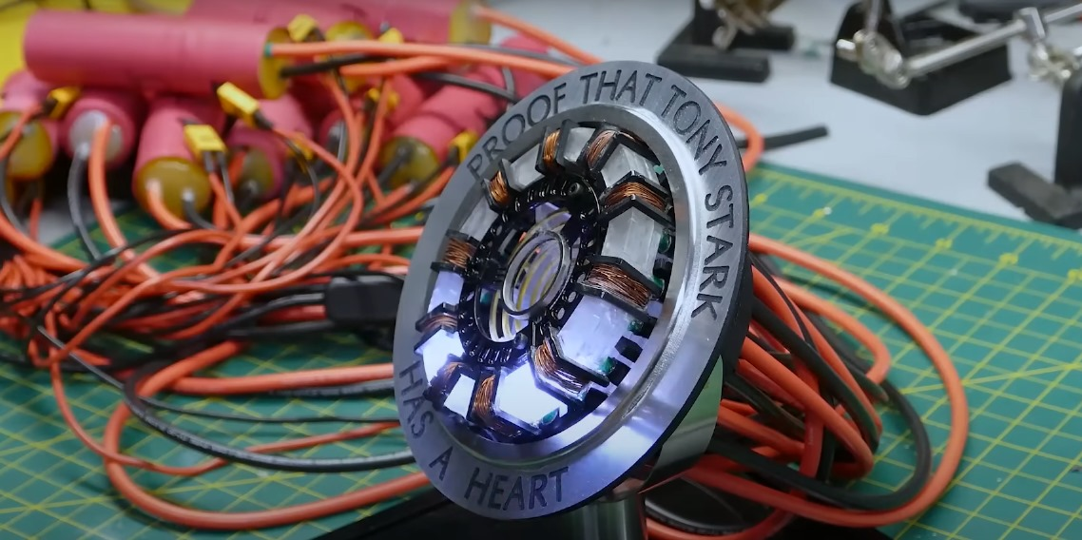
ARC REACTOR
It is the power source which provides electricity to the raspberry pi and other components.
Materials required:
Wires
Lithium battery (9V)

Slide 6
A GUI
It is user friendly interface which help user to get across functions
It is being made using python, tkinter
By using AI we can converse on a virtual environment which can help us in finding and analysing various objectives.

Slide 7
A Screen
It will give the real environment information from the distance and display the progress of objective.
It is connected with the motherboard (Raspberry pi) and a camera to show the real world as output.

Slide 8
Other Advanced Suits
Certain advanced suits such as those made in real life contains as well which are used to cut through things
Some types of LASER cutters are ,Giant industrial fibre LASER cutter and a new creality LASER cutter
Although LASER will not be a part of this suit but it has been a vital cog in previously built/shown Advanced Suits

Slide 9
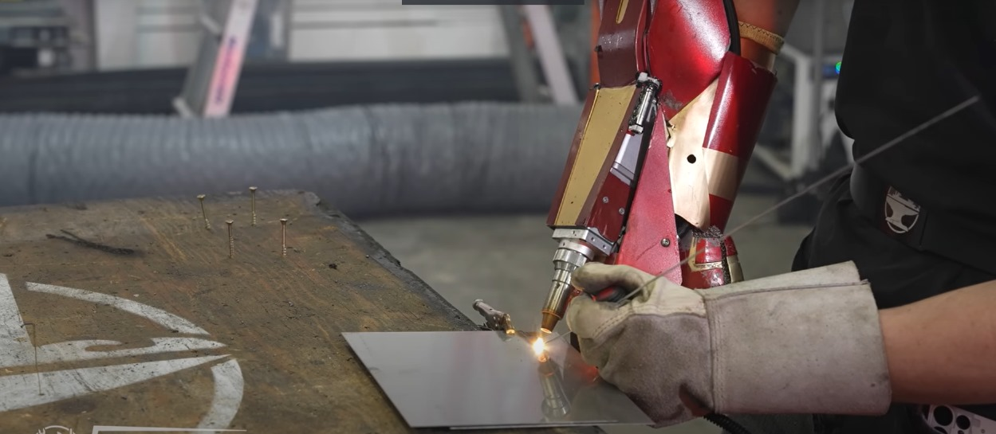
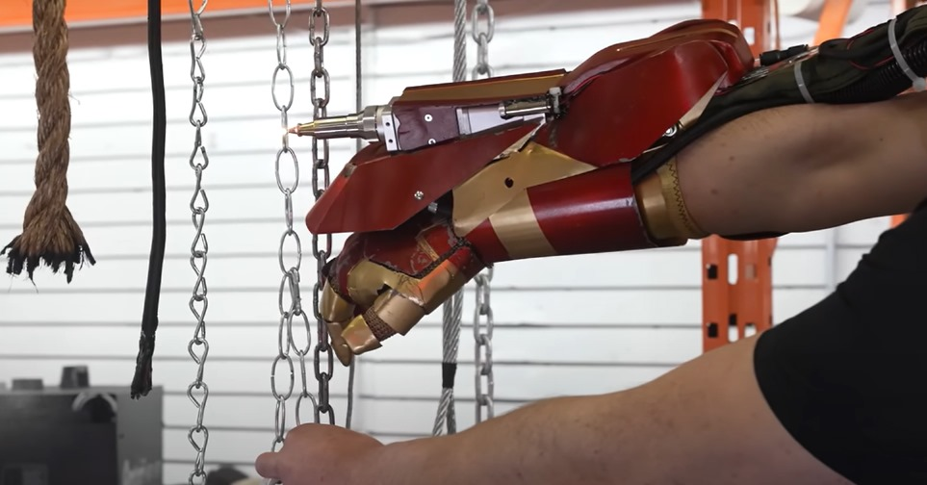
LASERs used in Advanced Suit

Slide 10
About Other Advanced Suits
Designs of some of the advanced suits are shown in figures on the next slides , although none of those are built for military.
Also , none of those support AI based environment yet.

Slide 11
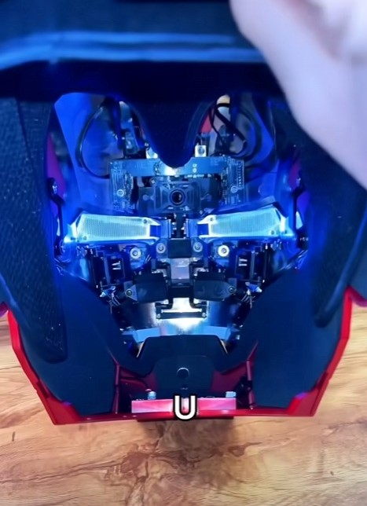
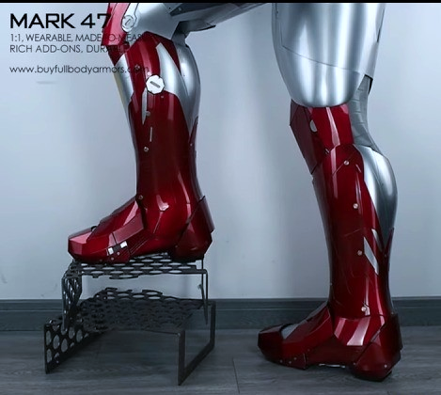

Slide 12
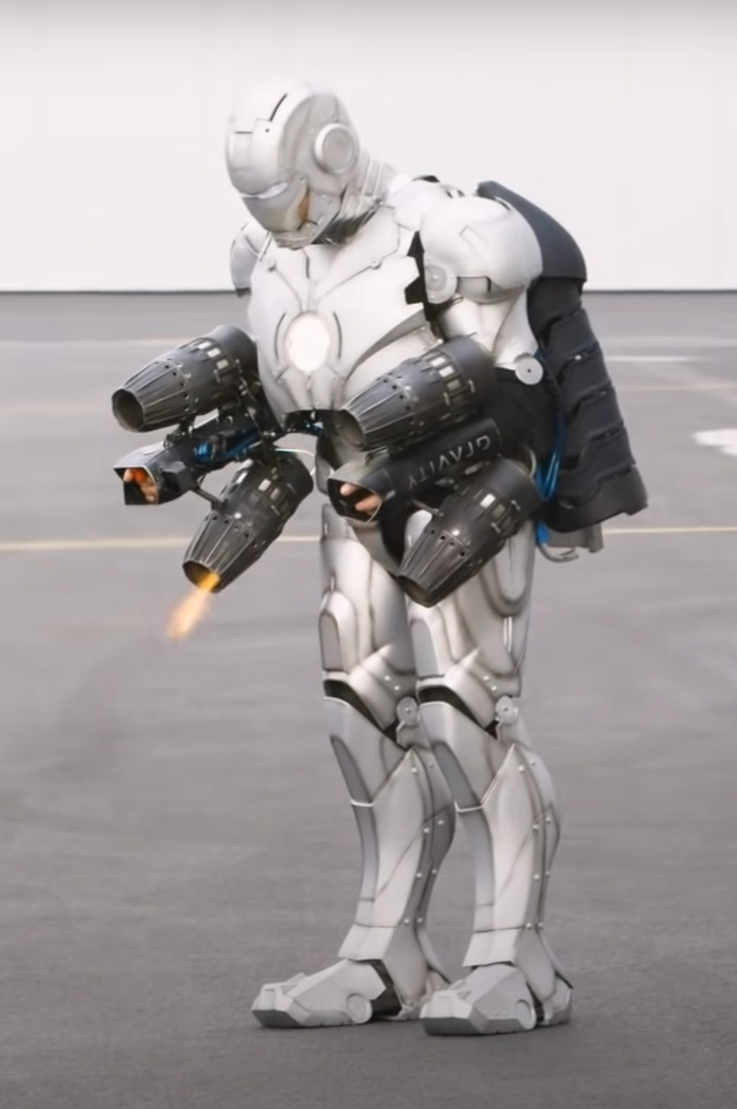
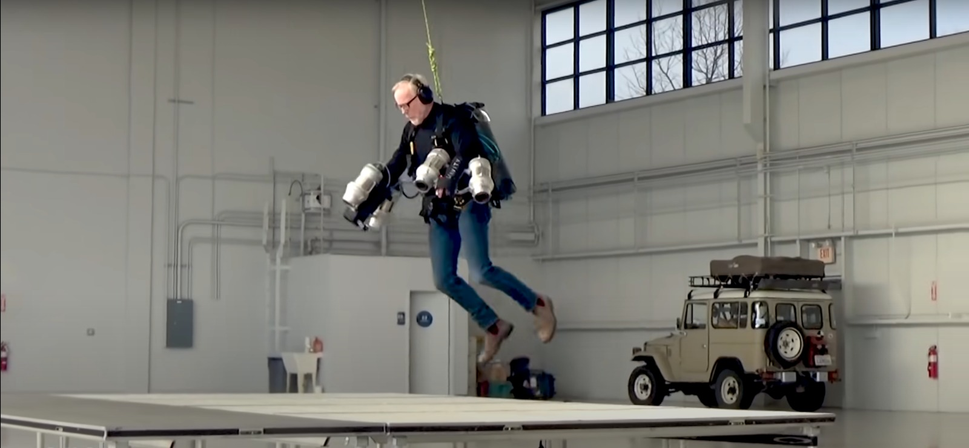

Slide 13
Work Distribution
Aman Sinha (Lead) *Research area- Future of Advance Military Suits.
*Idea and main-framework.
*Overall manager.
Naveen Kr Jha *Research area- Present analogy, advantage ,disadvantage of Advance Military Suits.
*Coding interface and debugging.
*Improvement in current coding environment on Raspbian.
Saumya Suman *Research area- Past use of advance suits in military and their outcomes.
*Control of sharing AI features with webpages or other media.
*Use Html and CSS to organise data and source code

Slide 14
Algorithm
If our models is similar to that of current Advance suits, if no then go to next line, else go to 12
If our models use code similar to current suits, if no then go to line 3, else go to 12
Shorten and debug code and then go to line 6
Use open-source libraries like pyttsx3, pywhatkit, speech recognition, tensorflow, etc, go to next line
Use VNC Server and Client method to create a virtual computer on a remote device, go to next line
Use Tkinter to create a GUI for user, go to next line
If camera pins and screen works properly, if no then go to next line, else go to line 8
Create first recording with pycamera, go to next line
Use MX Player to access video in .h264 or mp4 format, go to next line
Implement camera with Object detection code,
Enviroment scan
Facial detection

Slide 15
Algorithm
Object scanned information
Object can be lethal or not
Save current progress in a .py file, exit.
Do more Research

Slide 16
Progress report
Current work at raspberry allows user to see world from a remote view with just a button
Improvement implanted in GUI.
Suit is to be made such that the model can fit with almost any type of outfits(regular/casuals or military)
Mask is mandatory with optional other features, that can be ditched easily- cost cutting
Suit now has a GUI that enables user to access a few suit features
Camera can now detect objects
VNC services are enabled with touch screen features on the screen, enabling user to interact with voice or touch command and remote control.
Suit now has a very basic display of AI.

Slide 17
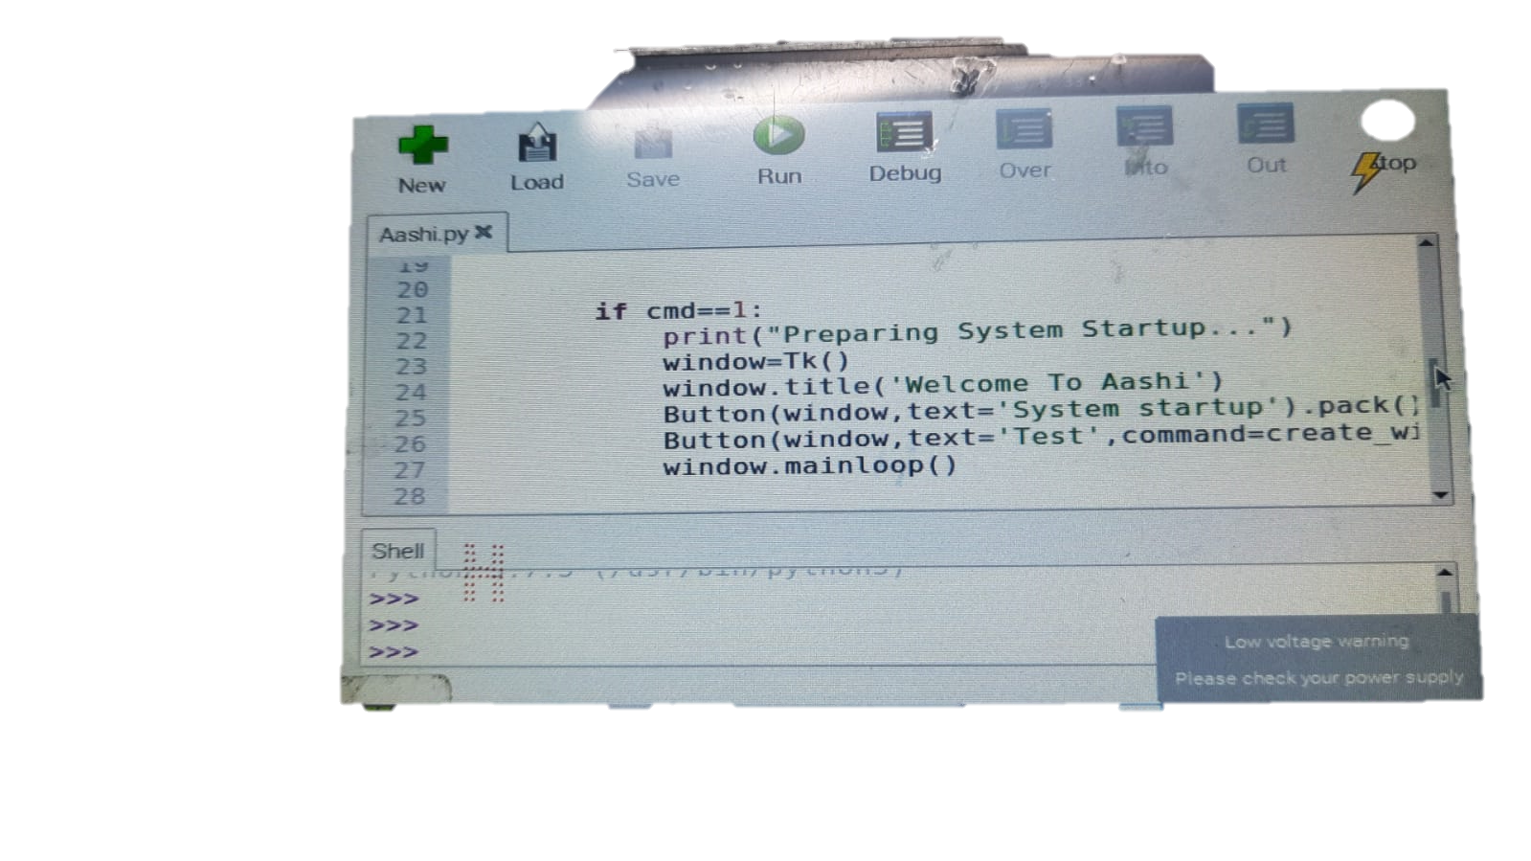
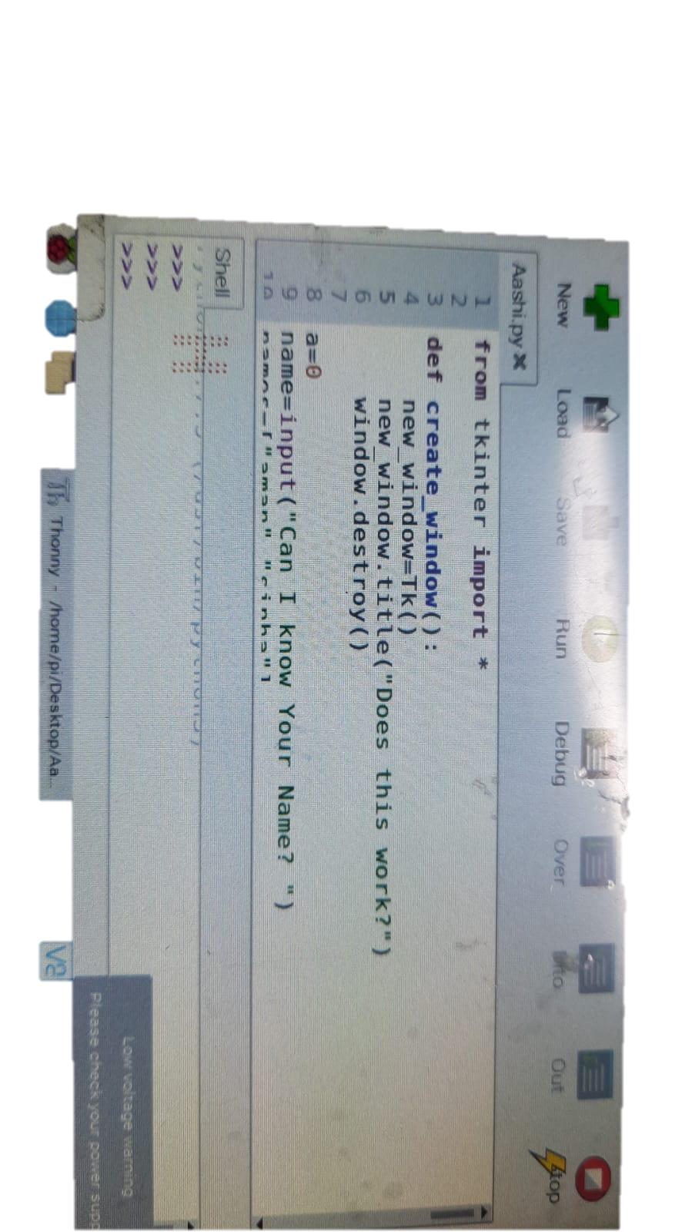
Design description
Graphic User Interface using tkinter
For making GUI we used python programming language we use libraries such as tkinter,cv2 etc
Create_window() function is used to create a window using tkinter
Button() function was used to make buttons such as”system startup” and “test “ as shown.

Slide 18
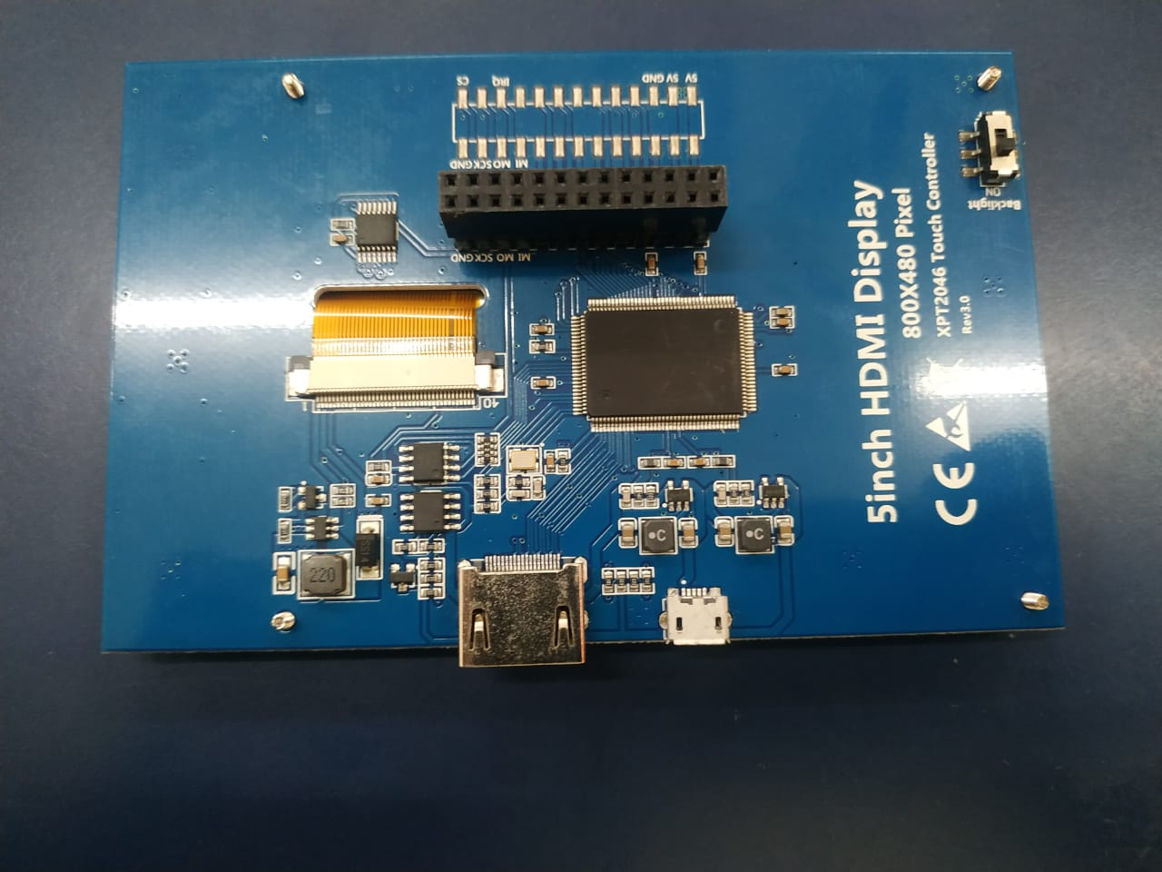
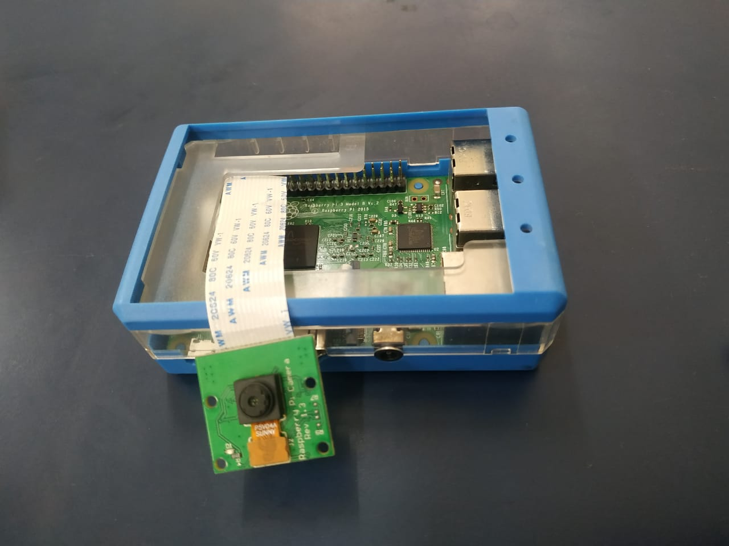

Slide 19
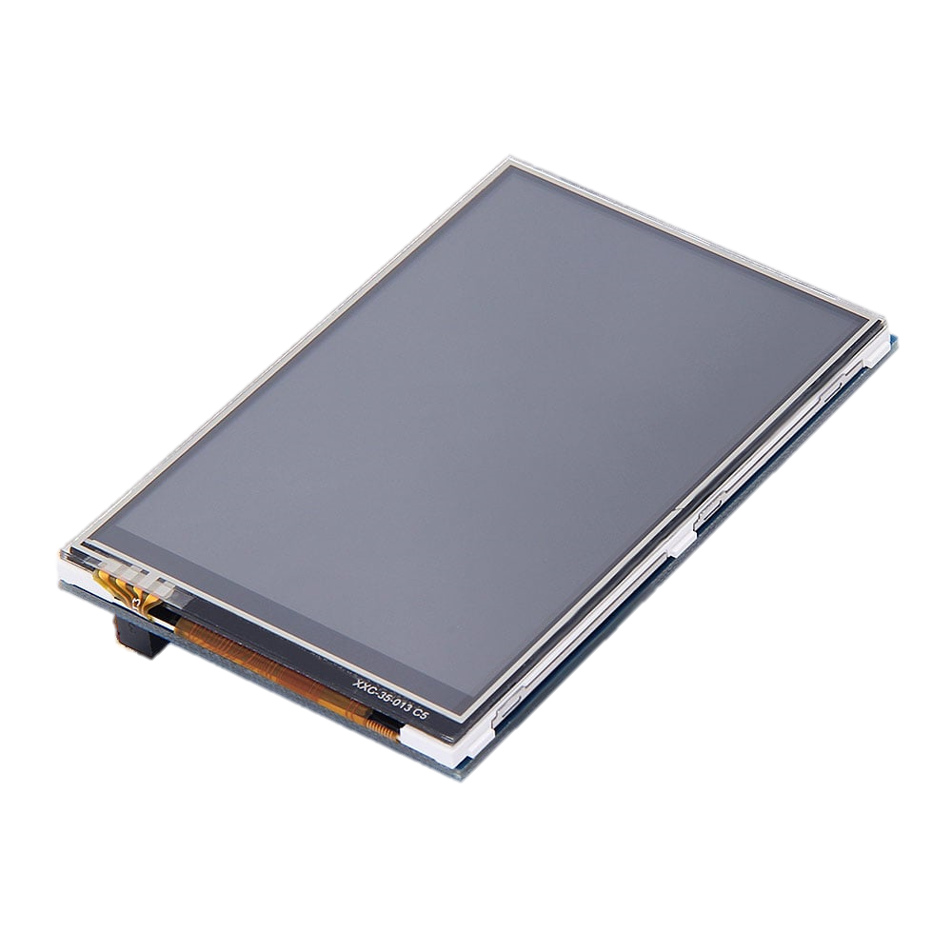
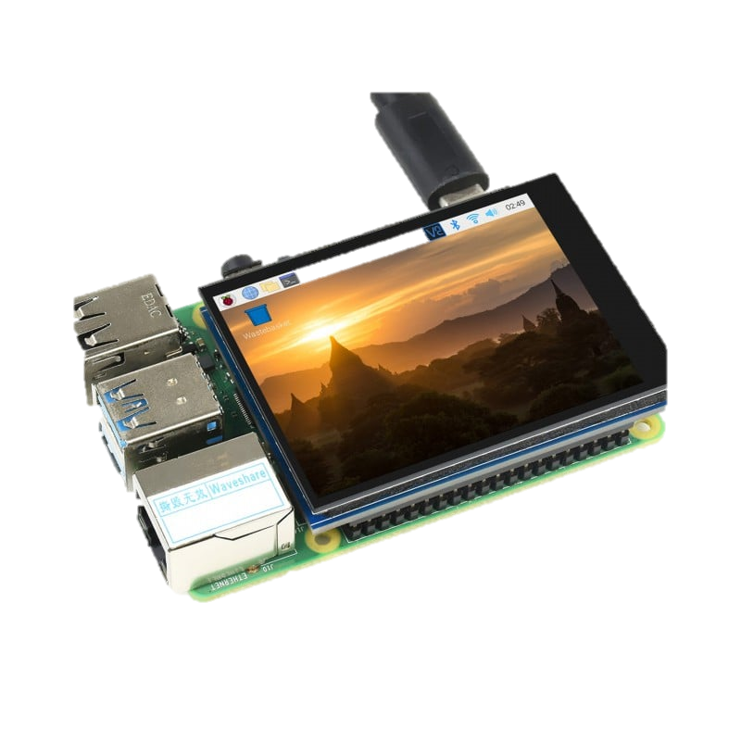

Slide 20
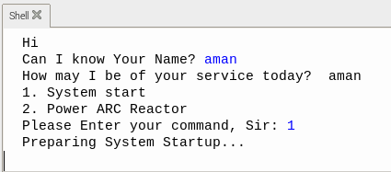
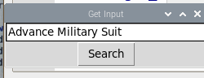
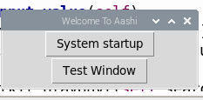
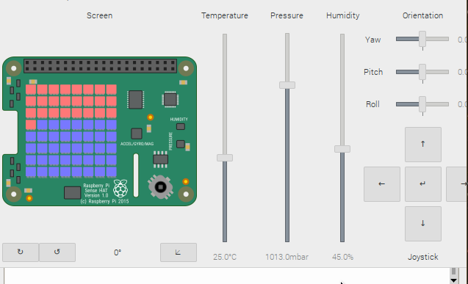
OUTPUTS

Slide 21
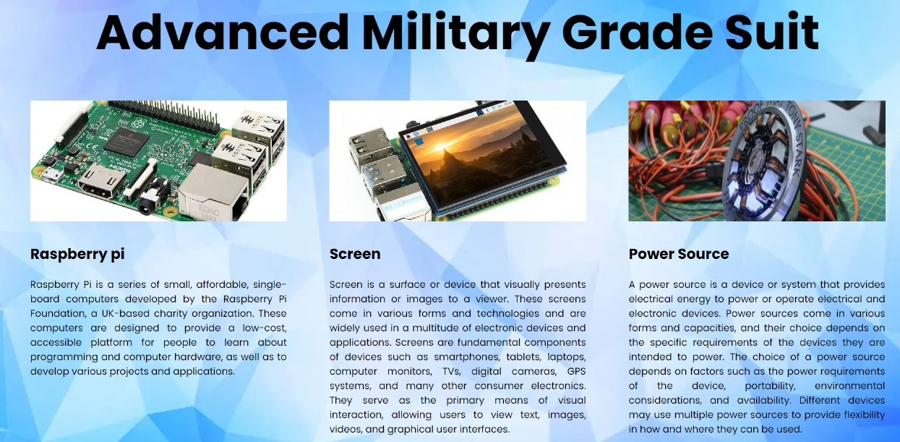
WEBSITE Overview

Slide 22
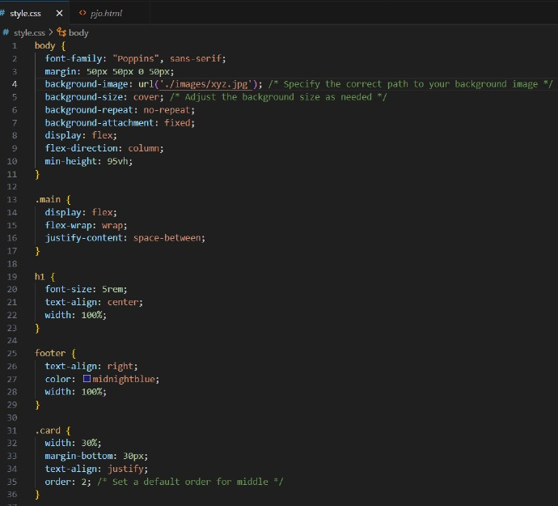
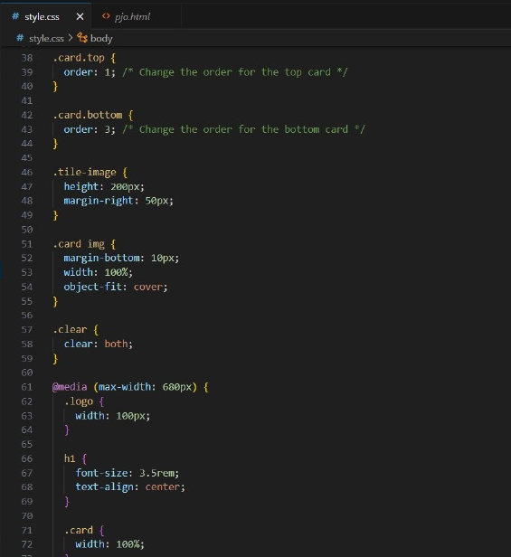
Website Creation

Slide 23
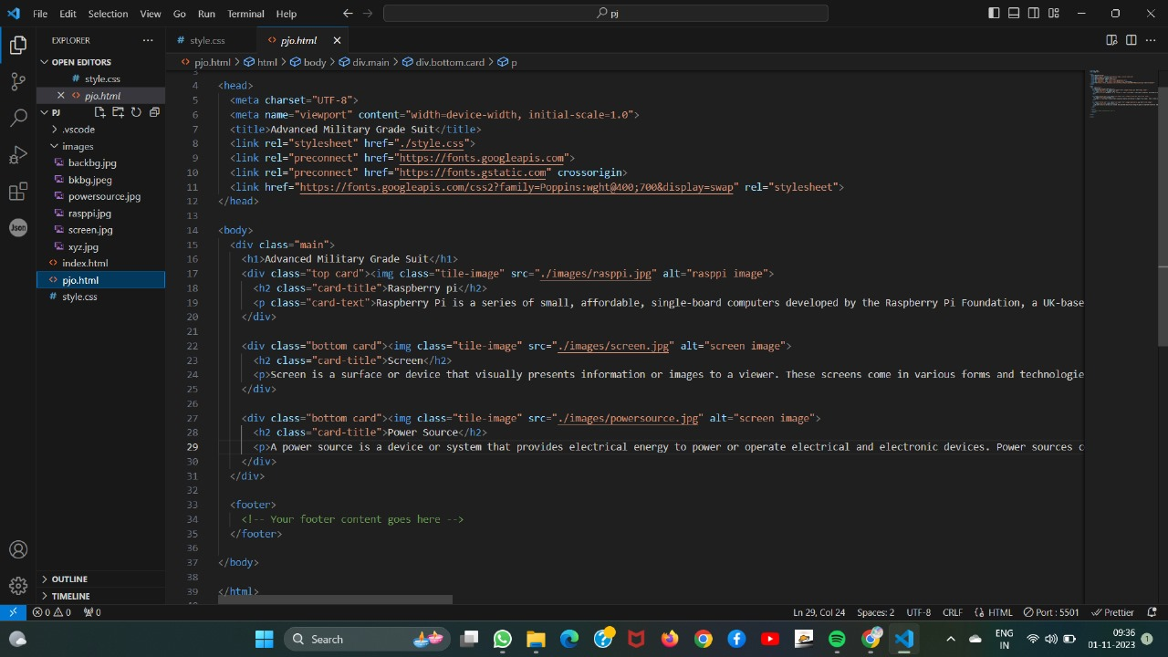
WEBSITE Code

Slide 24
Implementation
For GUI and Object detection Python libraries Used
Tensorflow & CV
Training Model for AI
tkinter
SenseHat from sense_emu
Functions used to formulate Interface
tkinter.Button
cv2.imread
cv2.Cascade
Technologies used for website creation
CSS (Cascading Style Sheets)
html

Slide 25
Thank You

